Slide 1
Remove this slide before presenting
This presentation package may be used for the purpose of educating health professionals about their role in advance care planning (ACP) in a WA context.
Formatting may be changed to suit your organisation’s needs.
Slides may be removed if the level of detail isn’t required.
Additional case studies, examples or tailored information may be needed depending on your audience. However, it is strongly recommended the key messaging in the slides is not altered.
The communication of consistent ACP-related messaging across WA will aim to reduce confusion and improve understanding of the ACP process and related documentation.
For queries, advice or assistance with using this package, please contact Department of Health WA ACP Team acp@health.wa.gov.au or 9222 2300.
Version 2 - June 2025

Slide 2
Advance care planning for health professionals
The information in this presentation is based on the Health Professional Guide to Advance Care Planning in Western Australia (health.wa.gov.au/ACP).

Slide 3
Acknowledgement of country
We acknowledge the Wadjuk people of the Noongar nation, the traditional custodians of this land who are resilient in their custodianship
We pay our respects to elders: past and present.
Notes:
*if necessary update “Wadjuk people” to the people of the land you are meeting on.

Slide 4
Learning outcomes
At the end of this session, you should be able to:
Explain advance care planning (ACP).
Identify opportunities or triggers in routine practice for raising ACP discussions.
Describe the role of health professionals in ACP and their role in communicating with individuals, families and the team.
Describe the range of advance care planning documentation available in WA and how they should be completed, stored or shared.

Slide 5
Introduction to advance care planning

Slide 6

What is advance care planning?
A voluntary process of planning for future health and personal care whereby the person’s values, beliefs and preferences are made known to guide decision-making at a future time when that person cannot make or communicate their decisions.
National Framework for Advance Care Planning Documents

Slide 7
Principles of ACP
Advance care planning:
is voluntary, person-centred
is an ongoing process and requires regular review
can be undertaken at any age, ideally commences before a person is unwell
is inclusive and can involve as many people a person chooses.
Notes:
WA Health has developed a set of principles to promote a common understanding of advance care planning and consistency in how health professionals support the process in WA.
Advance care planning is:
is voluntary, person-centred, and focused on empowering people to have choice and control over their future medical treatment decisions
is an ongoing process that a person can engage in at any time, and requires regular review allowing a person to make and change decisions as their circumstances and preferences change
can be undertaken at any age and ideally commences before a person is unwell
is inclusive and can involve as many, or as few, people a person chooses to involve (e.g. family, carers, friends, health professionals, legal professionals)

Slide 8
Principles of ACP
Advance care planning (cont.):
is holistic and respects the whole person
acknowledges and respects a person’s attitudes (including cultural and spiritual) towards health and wellbeing
focuses on the person’s values, priorities and preferences
may involve many, and sometimes challenging, discussions
needs to follow an ethical process.
Notes:
should be holistic and respect the whole person, with broad consideration of healthcare needs (i.e. not limited to medical treatments)
should acknowledge and respect a person’s attitudes towards health and wellbeing, including cultural and spiritual considerations
focuses on the person’s values, priorities and preferences and encompasses more than the completion of advance care planning documents
may involve many, and sometimes challenging, reflections and discussions; these may need to be facilitated to ensure the person understands all their options when it comes to planning for their future care
needs to follow an ethical process and support the person’s right to meaningfully participate in decision-making to the greatest extent possible.

Slide 9
The importance of ACP
Benefits of advance care planning
Opportunity to plan what is important for future care, and to take comfort in sharing.
Decision-making occurs without pressure of acute clinical decline
Helps people receive care consistent with their beliefs, values, needs and preferences.
Reduces non-beneficial transfers to acute care and unwanted interventions.
Improves patient and family satisfaction with care, and less anxiety, depression and stress.
Notes:
Advance care planning has a number of benefits for the person, their family, carers and for health professionals and organisations providing their care. A range of legislative requirements also inform requirements for advance care planning. Together these benefits and obligations justify the inclusion of advance care planning as part of routine care.
Benefits of ACP
Provides an opportunity for people to plan what is important for their future health and personal care, and to take comfort in sharing this with others.
Enables decision-making to occur by the person without the pressure of acute clinical decline.
Assists people to make decisions when they are able to communicate so they receive care that is consistent with their beliefs, values, needs and preferences if they become unable to communicate decisions.
Reduces non-beneficial transfers to acute care and unwanted interventions.
Improves patient and family satisfaction with care, with families experiencing less anxiety, depression and stress.

Slide 10
Legislation and frameworks outlining health professional obligations
The importance of ACP
Guardianship and Administration Act 1990
Criminal Code
Common Law
National Quality Standards for health services, general practice and aged care
Codes of conduct and professional guidelines.
Notes:
Health professionals and aged care workers have an obligation to provide care in accordance with the person’s Advance Health Directive and as directed by enduring guardians under the Guardianship and Administration Act 1990.
Other guidelines in relation to advance care planning are contained within:
National Quality Standards for health services, general practice and aged care
various codes of conduct and professional guidelines for both registered health practitioners and other health and aged care workers.

Slide 11
Guardianship and Administration
Act 1990
The importance of ACP
The Act enables individuals to complete an Advance Health Directive and/or an Enduring Power of Guardianship.
  outlines the Hierarchy of treatment decision-makers
  Valid Advance Health Directives and Enduring Powers of Guardianship are legal documents that must be followed by all health professionals. There are limited exceptional circumstances.
Notes:
The following slides provides a summary of relevant legislation in WA their implications for health professionals. It is important that health professionals understand their responsibilities and potential liabilities when enacting advance care planning documents.
The Act enables individuals to complete an Advance Health Directive and/or appoint an enduring guardian by completing an Enduring Power of Guardianship.
The Act outlines the Hierarchy of treatment decision-makers, which explains the order in which health professionals must consult decision-makers when seeking a treatment decision for a person who lacks the capacity to make their own judgements.
Valid Advance Health Directives and Enduring Powers of Guardianship are legal documents that must be followed be all health professionals. There are limited exceptional circumstances in which health professionals can disregard Advance Health Directives or the advice given by an enduring guardian.
For example, if circumstances relevant to a treatment decision have changed since the person made the treatment decision (e.g. a new treatment becomes available) and the person could not have reasonably anticipated the change at the time they made the treatment decision and it is reasonable that a person with knowledge of the change of circumstances would now change their mind.

Slide 12
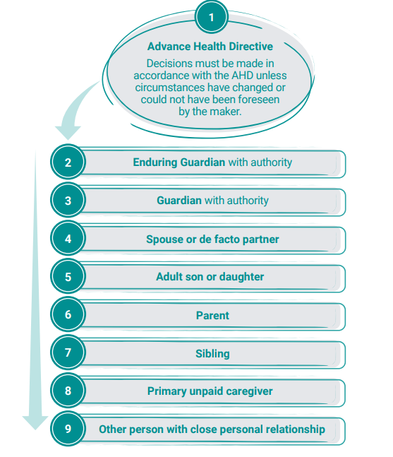
Hierarchy of treatment decision-makers
Notes:
When assisting people to decide which advance care planning documentation is right for them, it is useful to inform people of the Hierarchy of treatment decision makers. This explains the order of decision-makers that health professionals must follow when seeking a treatment decision for a person who lacks the capacity to make their own judgements. Advance Health Directives are at the top of the hierarchy.
Where an AHD does not exist or does not cover the treatment decision required, the health professional must obtain a decision for non-urgent treatment from the first person in the hierarchy who is 18 years of age or older, has full legal capacity and is willing and available to make a decision.

Slide 13
Criminal Code
The importance of ACP
Health professionals who act in good faith and with reasonable care and skill are legally protected if they withhold or withdraw treatment in accordance with an Advance Health Directive, a Common Law Directive or a decision by an Enduring Guardian, even when the person dies.

Slide 14
Common law
The importance of ACP
Common Law Directive - written or verbal
Conveys wishes for health treatment to be provided or withheld
No formal requirements, difficult to establish validity
Health professionals’ obligations to comply with a Common Law Directive are same as for AHDs
Not recommended for making treatment decisions
Notes:
Under common law, a person can prepare a written or verbal Common Law Directive that conveys their wishes for health treatment to be provided or withheld in specific future circumstances.
There are no formal requirements for Common Law Directives.
However they have legal standing under common law and health professionals must comply with a valid Common Law Directive in the same way as they would with an Advance Health Directive.
There can be significant difficulties in establishing that a particular Common Law Directive is valid at law and can be followed.
For this reason, it is not recommended that people develop a Common Law Directive for making treatment decisions. If you are uncertain whether a Common Law Directive is valid seek advice from your professional association.

Slide 15
Mental Health Act 2014
The importance of ACP
The requirement to follow an AHD for people with mental illness who lose capacity depends on whether the person is under voluntary or involuntary care.
If a person with mental illness makes an AHD when they have full legal capacity, and they subsequently lose capacity:
  the AHD must be respected and followed if the person is under voluntary care / treatment
  treatment without consent can be given if the person is under involuntary care and if the person’s psychiatrist believes the treatment to be in the person’s best interest.
Notes:
The requirement to follow an Advance Health Directive for people with mental illness who lose capacity depends on whether the person is under voluntary or involuntary care. If a person with mental illness makes an Advance Health Directive when they have full legal capacity, and they subsequently lose capacity:
the Advance Health Directive must be respected and followed if the person is under voluntary care / treatment
treatment without consent can be given if the person is under involuntary care and if the person’s Psychiatrist believes the treatment to be in the person’s best interest.

Slide 16
Roles and responsibilities of health professionals in advance care planning
Notes:
Possible video to show to introduce the topic:
WA Health video: Advance care planning – Everyone has a role (health.wa.gov.au/ACP)

Slide 17
Skills for effective ACP conversations
Roles and responsibilities
Effective communication skills:
  a non-biased and non-judgemental approach
  active listening
  attending and reflecting
  use of clarifying questions
  summarising.
Notes:
Any health professional with good communication skills can raise or positively respond to queries on advance care planning and encourage people to begin the process.
In particular, general practices are well placed to support patients with advance care planning, given many people have a long standing and trusted relationship with their general practitioner.
Effective communication skills include:
a non-biased and non-judgemental approach
active listening
attending and reflecting
use of clarifying questions
summarising.

Slide 18
Skills for effective ACP conversations cont.
Roles and responsibilities
Good communication allows people time to reflect and make considered and informed decisions.
Understand your own capability and recognise when to refer people for more support.
Encourage people to continue the ACP process and give them or direct them to further information.
Notes:
Good communication allows people time to reflect and make considered and informed decisions that reflect their views, values and preferences.
Many health professionals have the skills, confidence and expert knowledge to have in-depth advance care planning conversations and support people through the advance care planning process. Others may need additional training and support. Some health professionals may feel that discussions about advance care planning are beyond their scope of practice. It is important to understand your own capability and recognise when to refer people for more support.
Encourage people to continue the advance care planning process and give them or direct them to further information to reflect on and explore.
Useful tools
The Communication Skills Education Videos for Health Professionals (pasce.com.au) produced by Cancer Council WA, Palliative and Supportive Care Education (PaSCE) provide further information on communication skills in advance care planning and end-of-life discussions.
The End-of-Life and Palliative Care Education and Training Framework (health.wa.gov.au/Articles/A_E/End-of-Life-Education-and-Training-Framework) is a reference tool to identify the knowledge and skills required by health professionals and staff who care for people with end-of-life and palliative care needs.

Slide 19
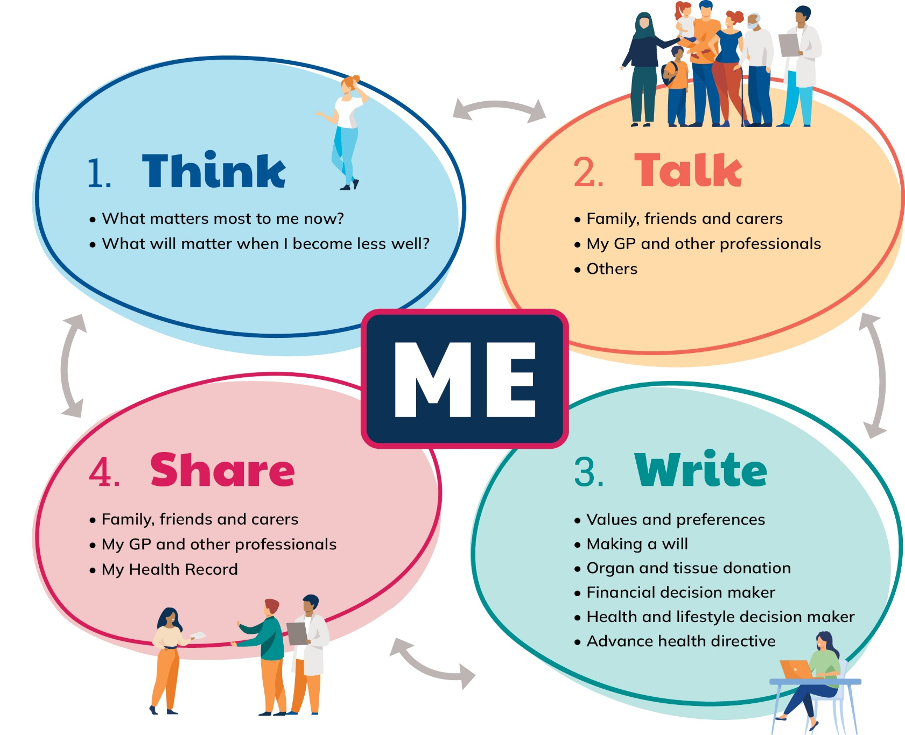
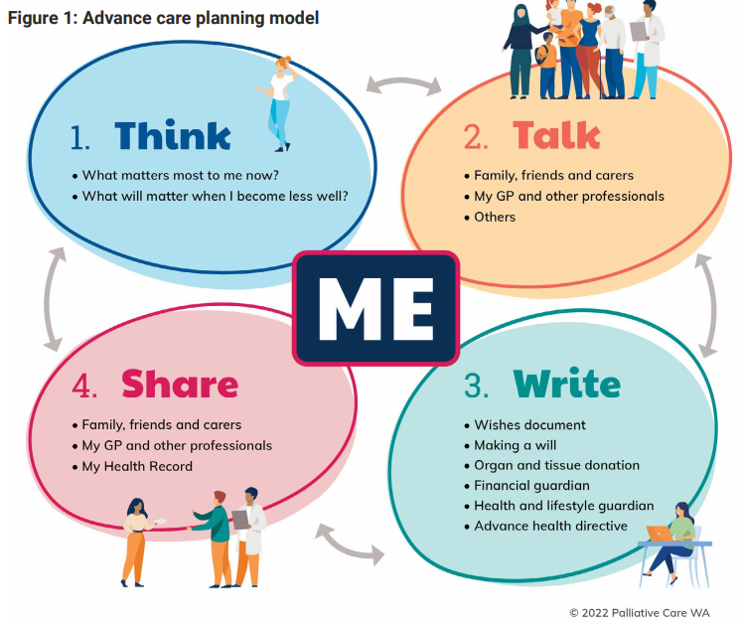
ACP model for consumers
Notes:
Health professionals have an important role in initiating conversations and supporting people through the process of advance care planning. Health professionals across the multidisciplinary team need to be able to facilitate advance care planning conversations effectively.
This ACP Model is developed by Palliative Care WA via the ACP Consortium. It outlines the four elements of advance care planning. Health professionals can use the model when explaining advance care planning to people.

Slide 20
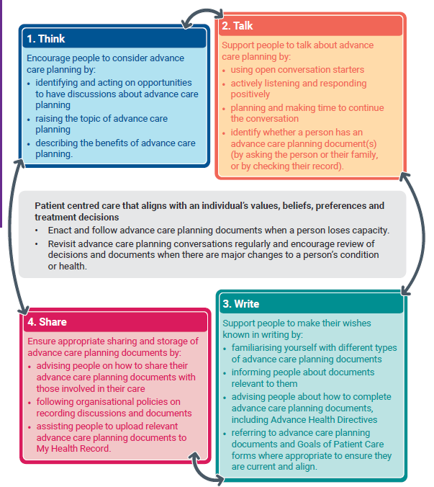
Role of health professionals in ACP
Notes:
This accompanying figure describes the role of health professionals in each of the elements.
Each element of the model will now be explored in more detail.

Slide 21

Preparing for advance care planning
Consider learning about advance care planning through relevant training and resources.
Familiarise yourself with relevant information resources.
Look for and take opportunities to talk to people about advance care planning.
Notes:
Link to training and resources webpage https://www.health.wa.gov.au/Articles/A_E/Advance-Care-Planning/Training-and-resources

Slide 22
Triggers to start or revisit ACP conversations
discussions of current or future treatment goals
scheduled health assessments
diagnosis of, or change in, a chronic or life-limiting illness or a disease that is likely to result in loss of capacity
changes in care arrangements or applications for assistance
if you would not be surprised if the person died within 12 months
Goals of Care discussions.
Notes:
Remember that advance care planning should be introduced early as part of routine care, rather than as a result of health decline or crisis.
Consider the person’s condition and when it might be appropriate or important to start or revisit advance care planning.
For people who are not interested in advance care planning, highlight the benefits. If they remain uninterested, let them know they can revisit the topic at any time.
Triggers to commence or revisit advance care planning conversations can include:
when a person or family member asks about current or future treatment goals
at scheduled health assessments
(i.e. a 75+years health assessment, Indigenous health assessment, GP Management Plans and Team Care Arrangements, chronic disease management consultations)
when an older person receives their annual flu vaccination
when there is a diagnosis of a chronic or life limiting illness
when there is a diagnosis of a metastatic malignancy or end organ failure indicating a poor prognosis
when there is a diagnosis of early dementia, a neurodegenerative disease or a disease which could result in loss of capacity
when someone is applying for assistance with care (i.e. Aged Care Assessment Teams (ACAT) assessment or applying for the National Disability Insurance Scheme (NDIS))
if you would not be surprised if the person died within twelve months
if there are changes in care arrangements
(e.g. admission to a residential aged care facility).

Slide 23
Useful tools
Supportive & Palliative Care Indicators Tool (SPICT™) spict.org.uk
ACP consumer resources healthywa.wa.gov.au/AdvanceCarePlanning
MBS items that may support advance care planning in general practice.
Notes:
Useful tools
The Supportive & Palliative Care Indicators Tool (SPICT™) (spict.org.uk) can help identify people with deteriorating health due to advanced conditions or serious illness, and can prompt the need for holistic assessment and future care planning. SPICT-4ALL aims to make it easier for everyone to recognise and talk about signs that a person’s overall health may be declining so that those people and their carers get better coordinated care and support whether they are at home, living in a residential care facility or in hospital.
The Dept of Health WA has recently released a suite of resources for consumers to learn more about ACP
There are no Medicare Benefits Schedule (MBS) items specifically for advance care planning, however there are MBS items that may support advance care planning in general practice https://www.advancecareplanning.org.au/__data/assets/pdf_file/0020/183206/acpa_mbs-factsheet_2018_online.pdf

Slide 24
Responding to someone with an interest in ACP
Be open to engage in ACP conversations
Acknowledge and validate the importance of the conversation
Provide or direct them to reliable, easy to read information
Encourage the person to talk with family and friends
Acknowledge and respect the person’s own beliefs and values
Recognise the different needs of
priority groups
Recognise ACP is an ongoing, evolving
process and plan time to continue the
conversations in the future.
ACP is voluntary
Notes:
Responding when someone approaches with an interest in ACP?
Be open to engaging in advance care planning conversations.
Acknowledge and validate the importance of the conversation.
Provide or direct people to reliable, easy to read information (e.g. Your Guide to Advance Care Planning in WA: A workbook to help you plan for your future care available from healthywa.wa.gov.au/advancecareplanning).
Encourage people to talk with their family and friends about what is important to them.
Acknowledge and respect the person’s own beliefs and values (be aware of and keep free from own biases).
Recognise the different needs of priority groups (e.g. people from culturally and linguistically diverse backgrounds, Aboriginal people, LGBTIQA+ people, people with disability).
Recognise advance care planning as an ongoing, evolving process and plan time to continue the conversations.
Remember that advance care planning is voluntary and people should not feel pressured to participate in discussions or write advance care planning documents.

Slide 25
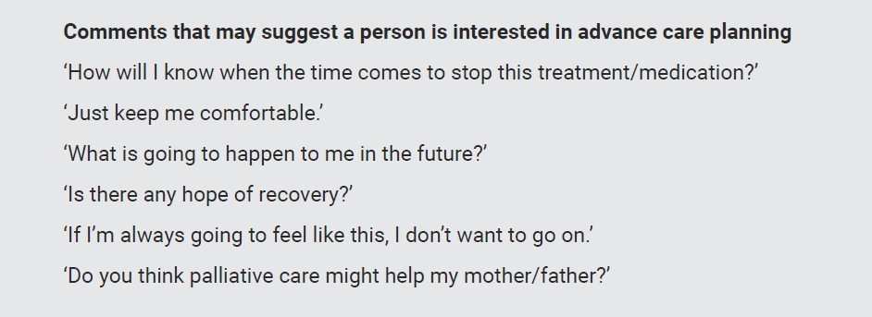

Slide 26
For more information visit:
Advance Care Planning Australia Video: Advance Care Planning as a part of routine care
Communication Skills Education Videos for health professionals produced by PaSCE
Notes:
*Consider showing a video during the education session

Slide 27

For a healthy person | ‘If you became unwell and were unable to make or communicate your own decisions, who would you want to make decisions on your behalf? Do you know what you would want them to say?’
 | ‘I talk to all my patients about what they would want if they become more unwell. Have you ever thought about this?’
 | ‘What does it mean to you to ‘live well’? What are your goals at this time?’
 | ‘I am pleased to see you recovering from your recent illness. If you became very sick again, have you thought about the treatment that you would want or not want?’
Notes:
Supporting advance care planning discussions
It is important for health professionals to be supportive of people who want to talk about advance care planning.
Normalising conversations can help them become a consistent part of care, with advance care planning discussed in the context of goals for healthy living and positive mental health.
In some instances, you may need to initiate the conversation. Examples of conversation starters may include, but are not limited to: (see table on slide)
Tips for supporting conversations about advance care planning
Look for opportunities to link advance care planning in with other existing processes i.e. Goals of Patient Care.
Remember to revisit advance care planning conversations regularly and review documents every 2 years or when there are major changes to a person’s condition or health.

Slide 28
For someone with a life-limiting illness(es) | ‘This is a long-term condition and there are going to be periods when you are well and periods when you will not be so well. What do you understand about where things stand right now with your illness? Would you like to discuss how we should approach your care during the times when you are not well? What is important to you? Who would you like me to involve?’
For someone expected to deteriorate or die within the next 12 months | ‘We have discussed what I think is likely to happen in the future. I would like to know more about how you think we should approach your care from here. What is important to you? Who would you like me to involve? Have you been thinking much about what happens?’
Notes:
Supporting advance care planning discussions
It is important for health professionals to be supportive of people who want to talk about advance care planning.
Normalising conversations can help them become a consistent part of care, with advance care planning discussed in the context of goals for healthy living and positive mental health.
In some instances, you may need to initiate the conversation. Examples of conversation starters may include, but are not limited to: (see table on slide)
Tips for supporting conversations about advance care planning
Look for opportunities to link advance care planning in with other existing processes i.e. Goals of Patient Care.
Remember to revisit advance care planning conversations regularly and review documents every 2 years or when there are major changes to a person’s condition or health.

Slide 29
Before you begin the discussion, consider:
Is the environment private and comfortable?
Who should be present?
Does the person have capacity to participate?
Is relevant clinical information available?
Are there cultural or religious considerations?
Do you need an interpreter?
Is extra time needed?
Notes:
Before you begin the discussion, consider:
Is the environment private and comfortable with no or minimal interruptions?
Who should be present?
Does the person, their family or carer have capacity to participate in the discussion?
Do you have all relevant clinical information available (review files and notes)?
Are there any cultural or religious needs to consider?
Do you need an interpreter to help with the discussion?
Is extra time needed for the appointment?

Slide 30

During the discussion:
Explain what ACP is
Things for the person to
consider:
  current health or health
  problems, family history
  concerns, worries or fears
  about future health care.
Review any existing advance care planning documents.
Notes:
During the discussion:
Explain what advance care planning is and why it may be useful for the person to talk about advance care planning with their family and friends. The person may want to consider:
current health and health problems and family history
concerns or worries about their future health care
their fears about their future health and wellbeing (e.g. pain, losing the ability to think, losing the ability to communicate, being dependent on loved ones, being removed from life support too soon)
any other concerns or worries.
Check whether the person already has an advance care planning document (e.g. Advance Health Directive and/or Enduring Power of Guardianship) and if so, whether it needs to be reviewed.
Tips for discussions about advance care planning
Use Your Guide to Advance Care Planning in Western Australia (available from healthywa.wa.gov.au/AdvanceCarePlanning) to facilitate discussions. This consumer guide walks people through things to consider about their health, values, preferences and future care.

Slide 31
When finishing up discussions...
Review
Clarify
Arrange follow-up
Summarise
Offer information
Notes:
When closing discussions:
Always review and summarise with the person and any others present and clarify any inconsistencies or misunderstandings. Offer take-home information and resources for the person to consider. Arrange further meetings or offer your contact details for future reference.
Encourage the person to continue discussions with others they trust including:
family
friends
carer(s)
enduring guardian(s)
other members of their healthcare team
legal professional
provider of cultural or spiritual support.

Slide 32
Advance Care Planning Australia Video: A nurse introduces advance care planning to her patient
Advance Care Planning Australia Video: Revisiting your advance care plan
Advance Care Planning Australia Video: Changing priorities and advance care planning
Communication Skills Education Videos for health professionals produced by PaSCE
Notes:
*Consider showing one of these videos during the education session

Slide 33

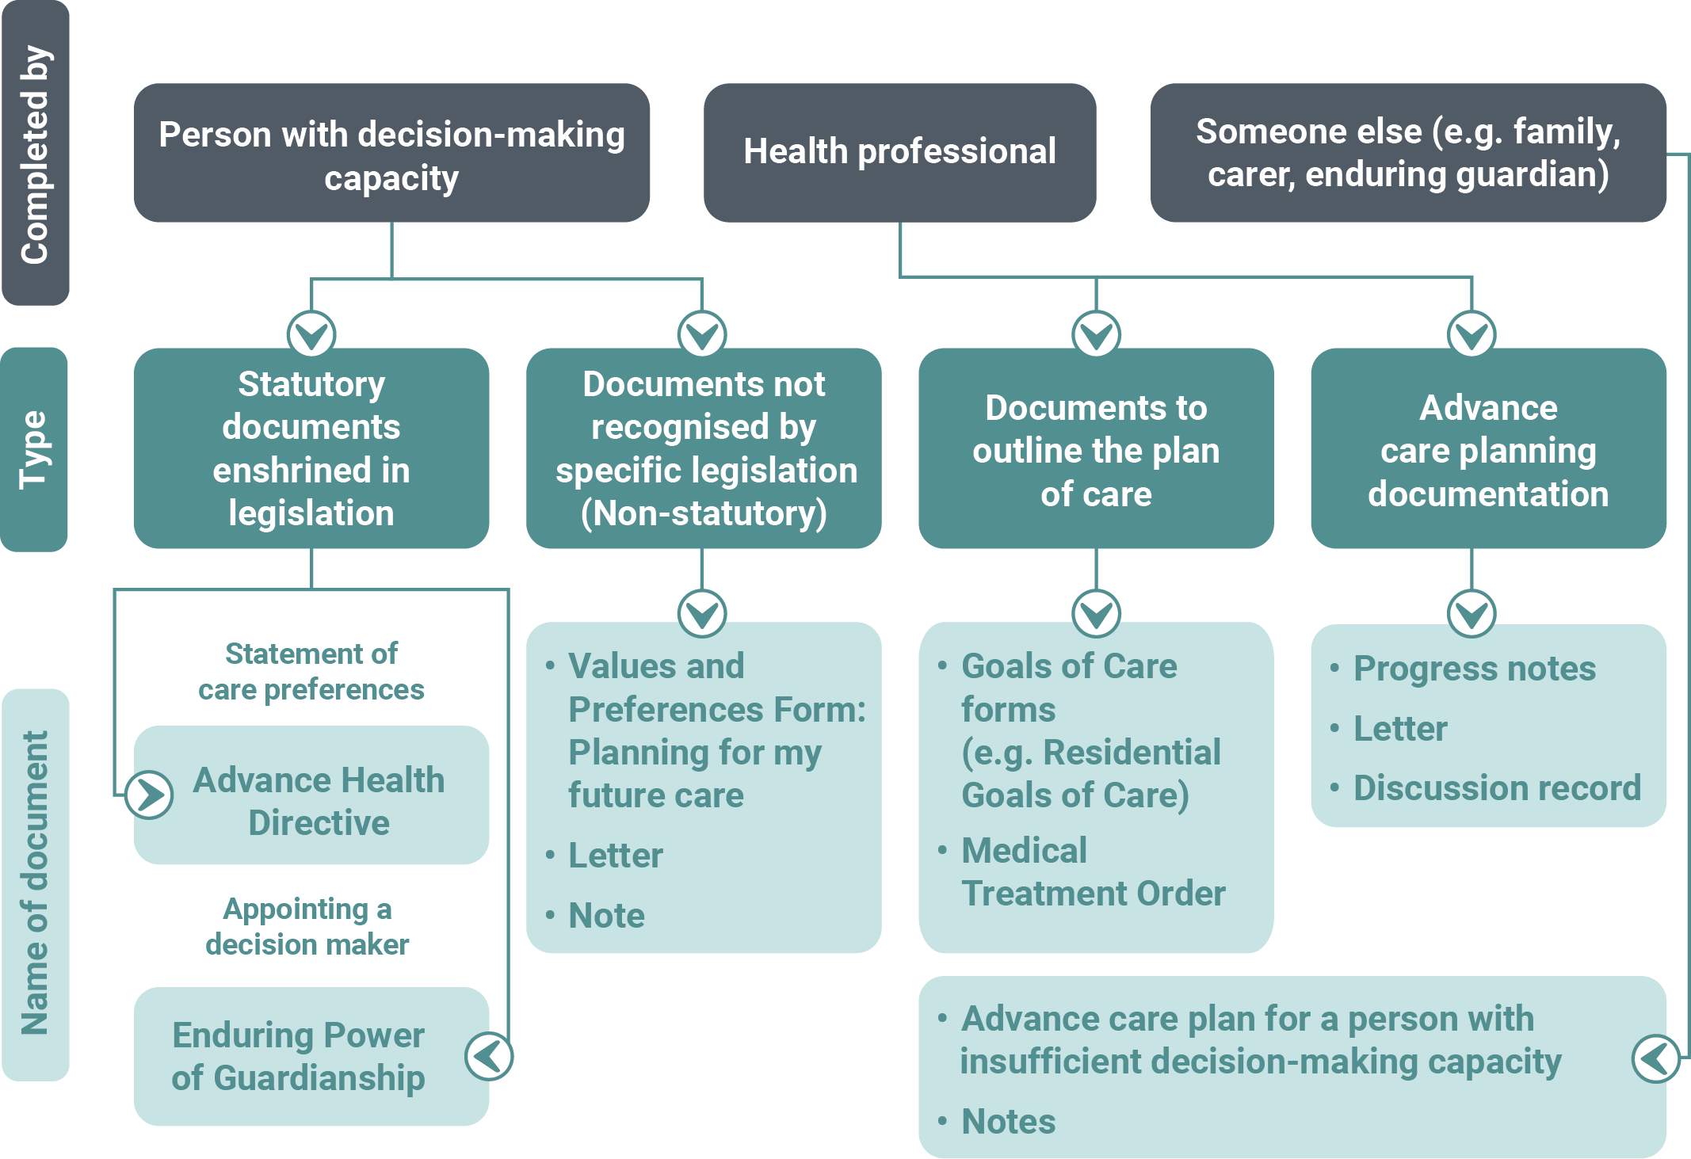
ACP documentation flowchart for WA
Notes:
It is recommended that people put their values, beliefs and preferences for future treatment in writing. A range of different advance care planning documents exist. Some are statutory and some are non-statutory.
Some documents are completed by the person, some by a health professional and some by another person such as a family member, carer or enduring guardian.
This flowchart provides an overview of the types of advance care planning documents that can be used in WA.
Tips for talking about advance care planning documents
When describing different documents, encourage the person to consider which document(s) are right for them.
The ‘Education and resources to assist with your role’ slides lists some services to support people with completing advance care planning documents.

Slide 34
Legal enforceability of ACP documents
Statutory documents
Recognised under legislation and must:
  be made by an adult with capacity
  be made by the individual, not by someone else on their behalf
  meet formal witnessing and signing requirements.
Have the strongest legal force and generally must be followed.
Notes:
A statutory advance care planning document (e.g. Advance Health Directive and Enduring Power of Guardianship) is the most formal way to record a person’s values, preferences and treatment decisions. Such documents are recognised under legislation and must:
be made by an adult with capacity
be made by the individual, not by someone else on their behalf
meet formal witnessing and signing requirements.
Because of these requirements, statutory documents have the strongest legal force and generally must be followed.

Slide 35
Legal enforceability of ACP documents
Non-statutory documents
Not recognised by specific legislation and do not carry the same legal force.
May be recognised as a Common Law Directive - they are not recommended for making treatment decisions.
All documents, including non-statutory, are important in terms of having conversations with loved ones who may become decision-makers for that individual in the future.
Notes:
Non-statutory documents are not recognised by specific legislation and do not carry the same legal force as a statutory document. In some cases, non-statutory documents may be recognised as a Common Law Directive. There can be significant difficulties in establishing that a particular Common Law Directive is valid at law and can be followed. For this reason, they are not recommended for making treatment decisions.
However non-statutory documents are important in terms of having conversation with loved one who may become decision-makers on an individual’s behalf in the future. It facilitates answering the question "has your loved one ever talked to you about what kinds of care they would want should they be unable to make a decision themselves?"
Individuals can consult a legal professional to ensure statutory documents related to advance care planning (and Common Law Directives if developed) are executed properly.

Slide 36
Seeking clarification on the validity of documents
Concerns with the validity should be discussed with the person (if they have capacity).
If they do not have capacity:
  follow your organisation’s internal process for resolution
  seek advice from your
  professional association
  lodge concerns with
  State Administrative
  Tribunal (SAT).
The SAT is the organisation responsible for resolving concerns/conflicts in relation to either an AHD/ EPG and can be contacted any time.
Notes:
If a health professional has concerns in relation to the validity of an AHD or EPG, it is recommended they discuss their concerns with the person (if they have capacity). If they do not have capacity, then the health professional should:
follow their organisation’s internal process for resolution of such concerns
seek advice from thier professional association
consider making an application to the State Administrative Tribunal (SAT) (sat.justice.wa.gov.au) if there is any doubt about whether an Advance Health Directive or EPG applies in a given situation, and / or if concerns cannot be resolved.
The SAT is the organisation responsible for resolving concerns/conflicts in relation to either an Advance Health Directive or Enduring Power of Guardianship and can be contacted at any time if a health professional or family member has concerns in relation to an Advance Health Directive or Enduring Power of Guardianship.

Slide 37
Supporting people to complete
ACP documents
discuss the options of ACP documents
provide advice and guidance about treatment decisions and potential outcomes
encourage the person to document medical treatment decisions in their own words
offer to provide written information to take away
recommend the person seeks medical and/or legal professional assistance for statutory documents or help from support organisations
Notes:
Health professionals can support people to document values, beliefs and preferences by:
discussing the options of different documents – noting which documents are statutory and which are not providing advice and guidance about treatment decisions to consider and the potential outcome(s) of their choices
encouraging the person to write down their decisions about medical treatment in their own words
offering written information for the person to take away and consider (including instructional guides for relevant documents)
recommending the person seeks medical and/or legal professional assistance when completing a statutory document(s)
refer people to relevant organisations for assistance
encouraging a review of advance care planning document(s) every 2 years or when there are major changes to a person’s condition or health.
When helping people decide which advance care planning documentation is right for them, it is useful to refer to the Hierarchy of treatment decision-makers (see earlier slide). This explains the order in which health professionals must consult decision-makers when seeking a treatment decision for a person who lacks capacity. Advance Health Directives are at the top of the hierarchy.
Tips for supporting a person to document their decisions
Find out about and stay up to date with advance care planning resources.
Understand the differences between statutory and non-statutory advance care planning documents.

Slide 38
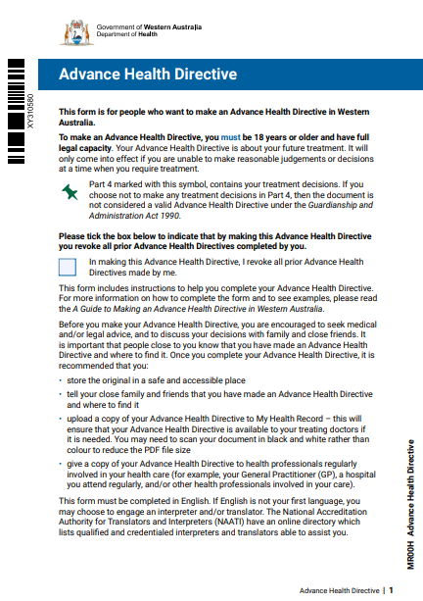
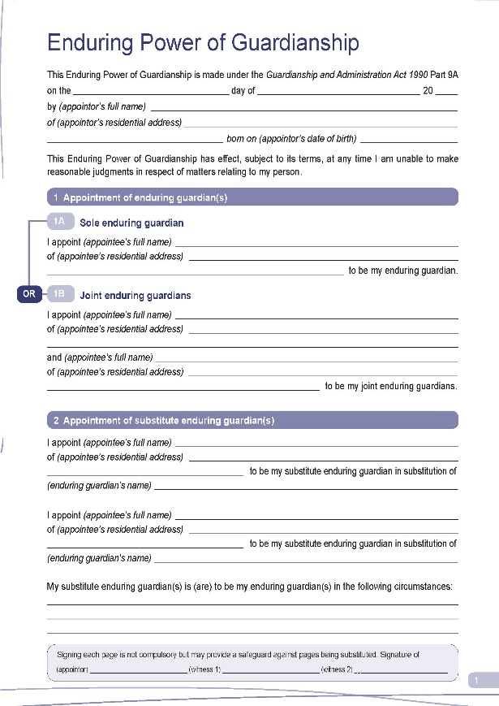
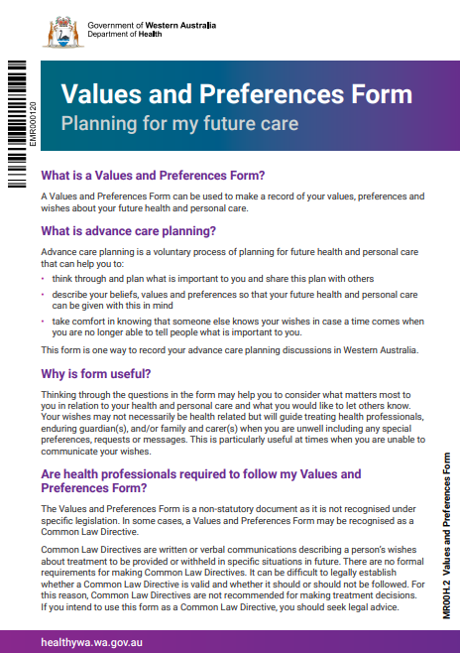
Documents completed by a person with decision-making capacity
Notes:
Advance Health Directive
Type of document: Statutory
An Advance Health Directive (AHD) is a legal document completed by a competent adult with which contains decisions regarding future medical treatment.
It specifies the treatment(s) for which consent is provided, refused or withdrawn under specific circumstances and only comes into effect if the person becomes incapable of making or communicating their decisions.
The term ‘treatment’ includes medical, surgical and dental treatments, including palliative care and life-sustaining measures.
An AHD would come into effect only if it applied to the treatment the person required and only if the person was unable to make reasoned judgements about a treatment decision at the time that the treatment was required.
Health professionals should be familiar with the Guide to Making an Advance Health Directive in WA (available from health.wa.gov.au/AHD) for instructions on how to complete an AHD.
Enduring Power of Guardianship
Type of document: Statutory
An Enduring Power of Guardianship (EPG) is a legal document in which a person nominates an enduring guardian to make personal, lifestyle and treatment decisions on their behalf in the event that they are unable to make reasonable judgments about these matters in future.
An EPG is different from an Enduring Power of Attorney (see below), which relates to financial and property matters.
A person can have more than one enduring guardian. However, if more than one enduring guardian is appointed, these individuals must act jointly, which means they must reach agreement on any decisions they make on the person’s behalf
Note – a person can have both an EPG and an AHD
My Values and Preference Form: Planning for my future care
Type of document: Non- statutory
A Values and Preferences Form is a statement of a person’s values, preferences and wishes in relation to their future health and care.
Wishes may not necessarily be health-related but will guide treating health professionals, enduring guardian(s), family members and carers in how a person wishes to be treated, including any special preferences, requests or messages.
In some cases, this may be considered a valid Common Law Directive – although this is not the recommended format to make treatment decisions.
The questions in this form are the same as the ‘Values and preferences’ section of the Advance Health Directive. If people are not yet ready to complete a full Advance Health Directive with formal witnessing and signing requirements, they may like to start with a Values and Preferences Form. They can then use this information when completing an Advance Health Directive if/when they decide to do so.
*Each of these documents are now presented on individual slides if you session requires more in-depth discussion of each.

Slide 39
Advance Health
Directive
Notes:
Advance Health Directive
Type of document: Statutory
An Advance Health Directive (AHD) is a legal document completed by a competent adult with which contains decisions regarding future medical treatment.
It specifies the treatment(s) for which consent is provided, refused or withdrawn under specific circumstances and only comes into effect if the person becomes incapable of making or communicating their decisions. The term ‘treatment’ includes medical, surgical and dental treatments, including palliative care and life-sustaining measures.
An AHD would come into effect only if it applied to the treatment the person required and only if the person was unable to make reasoned judgements about a treatment decision at the time that the treatment was required.
Health professionals should be familiar with the Guide to Making an Advance Health Directive in WA (available from health.wa.gov.au/AHD) for instructions on how to complete an AHD.
An Advance Health Directive cannot be used to:
• request voluntary assisted dying as this requires a person to have decision-making capacity throughout the entire process (individuals who are considering VAD can be referred to the WA VAD Statewide Care Navigator Service for support - email VADcarenavigator@health.wa.gov.au or call 9431 2755)
• request or authorise a health professional to take active steps to unnaturally end life
• request specific interventions that are not clinically indicated
• request treatment that is considered to be medically futile
• record wishes about organ and tissue donation - an AHD is ineffective after death.
Note – a person can have both an EPG and an AHD

Slide 40
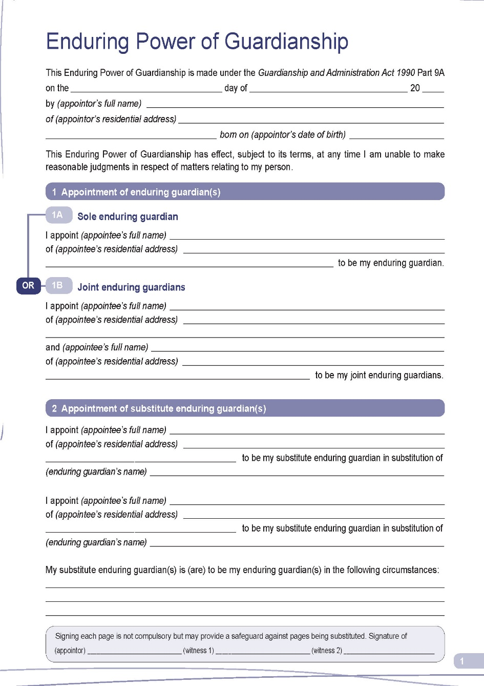
Enduring Power of Guardianship
Notes:
Type of document: Statutory
An Enduring Power of Guardianship (EPG) is a legal document in which a person nominates an enduring guardian to make personal, lifestyle and treatment decisions on their behalf in the event that they are unable to make reasonable judgments about these matters in future.
An EPG is different from an Enduring Power of Attorney, which relates to financial and property matters.
A person can have more than one enduring guardian. However, if more than one enduring guardian is appointed, these individuals must act jointly, which means they must reach agreement on any decisions they make on the person’s behalf
Note – a person can have both an EPG and an AHD

Slide 41
Values and
Preferences Form
Notes:
My Values and Preference Form: Planning for my future care
Type of document: Non- statutory
A Values and Preferences Form is a statement of a person’s values, preferences and wishes in relation to their future health and care.
Wishes may not necessarily be health-related but will guide treating health professionals, enduring guardian(s), family members and carers in how a person wishes to be treated, including any special preferences, requests or messages.
In some cases, this may be considered a valid Common Law Directive – although this is not the recommended format to make treatment decisions.
The questions in this form are the same as the ‘Values and preferences’ section of the Advance Health Directive. If people are not yet ready to complete a full Advance Health Directive with formal witnessing and signing requirements, they may like to start with a Values and Preferences Form. They can then use this information when completing an Advance Health Directive if/when they decide to do so.

Slide 42
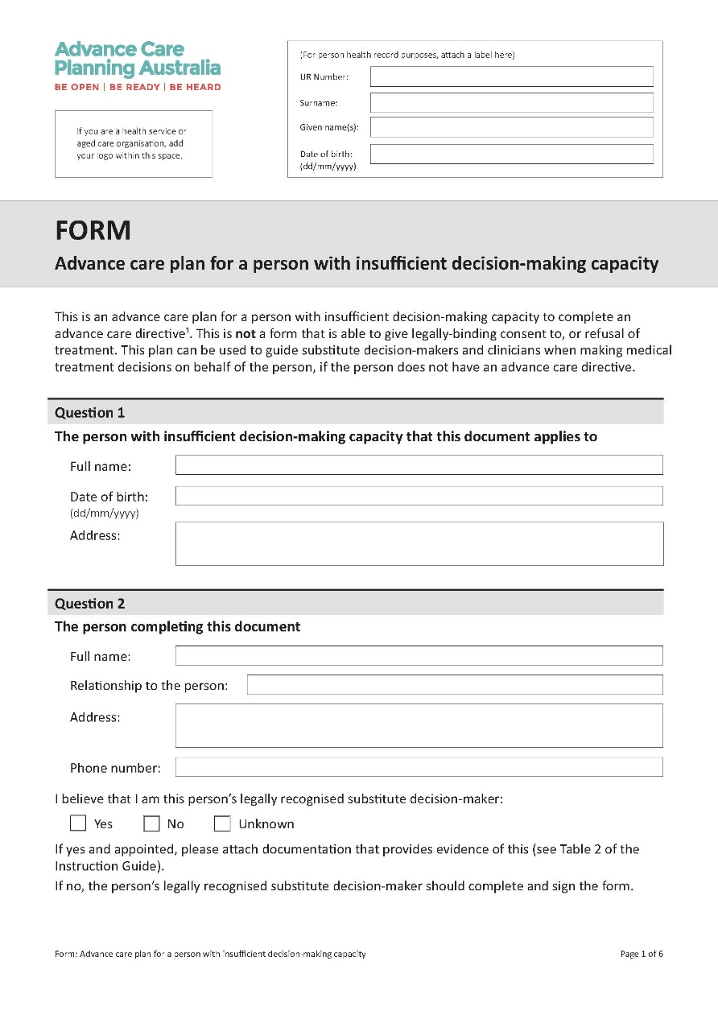
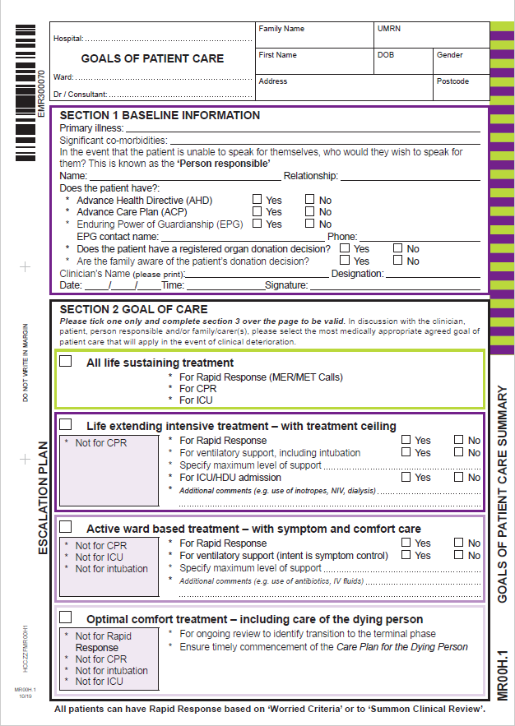
Documents completed on a person’s behalf
Notes:
https://www.advancecareplanning.org.au/__data/assets/pdf_file/0029/178427/advance-care-plan_full-name.pdf
Type of document: Non-statutory
An Advance Care Plan for someone with insufficient decision-making capacity is an advance care plan that can be completed by a person’s recognised decision-maker(s) (i.e. person highest on the Hierarchy of treatment decision-makers who is available and willing to make decisions) who has a close and continuing relationship with the person. This plan can be used to guide decision-makers and health professionals when making medical treatment decisions on behalf of the person, if the person does not have an Advance Health Directive or Values and Preferences Form. It should only be used when a person no longer has sufficient decision-making capacity to complete an Advance Health Directive or Values and Preference Form. This form cannot be used to give legal consent to, or refusal of treatment.
Ww2.health.wa.gov.au/Articles/F_I/Goals-of-patient-care
Type of document: Non-statutory
Goals of Patient Care (GoPC) establishes the most medically appropriate, realistic, agreed goal of patient care that will apply in the event of clinical deterioration, during an episode of care. GoPC and advance care planning are separate but related processes. A GoPC form is available for use in WA. This document prompts and facilitates proactive shared decision-making between treating health professionals, the person and their families.
The GoPC form has been adapted for use in different settings of care e.g. the Paediatric GoPC and the Residential Goals of Care Form. GoPC forms have a number of benefits including:
they can describe care during clinical deterioration especially in the absence of formal advance care planning documents.
GoPC eForms can easily be updated, stored and shared across healthcare settings especially when uploaded to My Health Record.
GoPC forms should align with the person's advance care planning documents and may include treatment decisions that were not considered when the person prepared their advance care planning documents. The content of any advance care planning document should be discussed during a GoPC discussion. The health professional should ask the person if they agree to store a copy of their advance care planning or GoPC in the medical record and upload it to My Health Record.
*Each of these documents are now presented on individual slides if you session requires more in-depth discussion of each.

Slide 43
Document is completed on behalf of a person with in-sufficient decision-making capacity
Advance Care Plan for
a person with insufficient
decision-making capacity
Notes:
https://www.advancecareplanning.org.au/__data/assets/pdf_file/0029/178427/advance-care-plan_full-name.pdf
Type of document: Non-statutory
An Advance Care Plan for someone with insufficient decision-making capacity is an advance care plan that can be completed by a person’s recognised decision-maker(s) (i.e. person highest on the Hierarchy of treatment decision-makers who is available and willing to make decisions) who has a close and continuing relationship with the person. This plan can be used to guide decision-makers and health professionals when making medical treatment decisions on behalf of the person, if the person does not have an Advance Health Directive or Values and Preferences Form. It should only be used when a person no longer has sufficient decision-making capacity to complete an Advance Health Directive or Values and Preference Form. This form cannot be used to give legal consent to, or refusal of treatment.

Slide 44
Document is completed by a health professional in collaboration with the patient
Goals of Care
Notes:
Ww2.health.wa.gov.au/Articles/F_I/Goals-of-patient-care
Type of document: Non-statutory
Goals of Patient Care (GoPC) establishes the most medically appropriate, realistic, agreed goal of patient care that will apply in the event of clinical deterioration, during an episode of care. GoPC and advance care planning are separate but related processes. A GoPC form is available for use in WA. This document prompts and facilitates proactive shared decision-making between treating health professionals, the person and their families.
The GoPC form has been adapted for use in different settings of care e.g. the Paediatric GoPC and the Residential Goals of Care Form. GoPC forms have a number of benefits including:
they can describe care during clinical deterioration especially in the absence of formal advance care planning documents.
GoPC eForms can easily be updated, stored and shared across healthcare settings especially when uploaded to My Health Record.
GoPC forms should align with the person's advance care planning documents and may include treatment decisions that were not considered when the person prepared their advance care planning documents. The content of any advance care planning document should be discussed during a GoPC discussion. The health professional should ask the person if they agree to store a copy of their advance care planning or GoPC in the medical record and upload it to My Health Record.

Slide 45
Other documents related to ACP
Be aware of where to refer people for assistance if these topics are raised
Organ and tissue donation – DonateLife
Wills – Public Trustee
Enduring Power of Attorney – Office of the Public Advocate
Notes:
Other topics that are not related to health or that cant be recorded in advance care planning documents may arise during discussions. Be aware of where to refer people for assistance if these topics are raised.
Organ and tissue donation
Organ and tissue donation is not technically a part of advance care planning as it occurs after the person has died. However, people may ask about organ and tissue donation during advance care planning conversations. Preferences for organ and tissue donation cannot formally be registered using advance care planning documents. Refer people to donatelife.gov.au/ to formally register their wishes for organ and tissue donation.
It is important for people to talk to family about their wishes, as relatives will be asked to agree before organ and tissue donation occurs.
Wills
A will is a written, legal document that says what a person wants to do with their money and belongings when they die. Refer to the Public Trustee www.publictrustee.wa.gov.au
Enduring Power of Attorney (EPA)
An enduring power of attorney is a legal agreement that enables a person to appoint a trusted person - or people - to make financial and property decisions on their behalf. Refer to the Office of the Public Advocate. Justice.wa.gov.au/EPA

Slide 46

Storing and sharing discussions and decisions
Record details of ACP discussions
Place written documentation in person’s file
Include copies of documents and discussions in clinical handover for transfer to another care setting
Notes:
It is best practice for health professionals to:
record details of advance care planning discussions including:
individuals present
others consulted in relation to the decisions made
details of topics discussed e.g. what the person considers acceptable treatment and any specific treatment decisions
put written documentation (e.g. notes and copies of advance care planning documents) in the person’s file in a consistent and accessible section
include copies of the advance care planning documents or notes about discussions in clinical handover for transfer to another care setting

Slide 47

Storing and sharing discussions and decisions
Advise to store:
  Original in safe place
  Upload to My Health Record
Encourage to share with:
  Family/friends/carers
  Enduring guardian (EPG)
  GP/specialist/ health professional
  Local hospital
  Residential aged care home
  Legal professional
Consider an AHD Alert Card or Medic Alert
Write a list of people who have a copy
Notes:
encourage individuals to upload their advance care planning documents to their My Health Record (digitalhealth.gov.au/healthcare-providers/advance-care-planning), and if necessary, assist them to do so (this can also be done on the person’s behalf if they have appointed an authorised or full access nominated representative to access their My Health Record)
recommend people keep original advance care planning documents in a safe place and share copies with as many of the following people they trust and feel comfortable with:
family, friends and carers
enduring guardian(s) (EPG)
enduring attorney(s) (EPA)
GP or local doctor
other specialist(s) or health professionals involved in their care
residential aged care facility
local hospital
legal professional.
advise people to keep a list of everyone who has a current copy of their advance care planning documents so they can be contacted if they revoke or update the document(s) in future.
Tips for sharing advance care planning documents
An AHD Alert Card (https://www.healthywa.wa.gov.au/~/media/Files/HealthyWA/Original/AHD-Alert-Card.pdf) or a Medic Alert www.medicalert.org.au can also be considered as a way of letting people know a person has an advance care planning document.
More information
Refer to relevant organisational policies and procedures for instruction on recording advance care planning discussions and documents. e.g. WA Clinical Alert (MedAlert) Policy (health.wa.gov.au/About-us/Policy-frameworks)
National Guidelines using My Health Record to store and access advance care planning and goals of care documents (digitalhealth.gov.au/healthcare-providers/advance-care-planning)

Slide 48
The revised Advance Health Directive in WA

Slide 49
What are the changes to the AHD?
The revised AHD in WA
Includes the individual’s values and preferences, in addition to treatment decisions
Combines tick box and free text questions
More guidance and examples
Includes consent to medical research

Slide 50
The revised AHD in WA
What are the benefits of these changes?
Easier to understand and complete
Guides the process for all involved
Informs health professionals about the person’s values and preferences
Greater focus on person-centred care
Support goals of care and shared decision making
Supports evaluation of person-centred decision-making (as per NSQHSS)
Notes:
Easier for patients to understand and complete
Guides the process for both the patient and health professionals
Informs health professionals about their patient’s values and preferences
Greater focus on patient-centred care
Supports goals of care and shared decision-making
Demonstrates patient-centred decision making (as per NSQHSS)

Slide 51
An AHD cannot be used to:
The revised AHD in WA
Request voluntary assisted dying (VAD)
Request or authorise a health professional to take active steps to unnaturally end life
Request specific interventions that are not clinically indicated
Request treatment which is considered to be medically futile
Record wishes about organ and tissue donation
Notes:
An Advance Health Directive cannot be used to:
• request voluntary assisted dying as this requires a person to have decision-making capacity throughout the entire process (individuals who are considering VAD can be referred to the WA VAD Statewide Care Navigator Service for support - email VADcarenavigator@health. wa.gov.au or call 9431 2755)
• request or authorise a health professional to take active steps to unnaturally end life
• request specific interventions that are not clinically indicated
• request treatment that is considered to be medically futile
• record wishes about organ and tissue donation - an AHD is ineffective after death.

Slide 52
When should an AHD be enacted?
The revised AHD in WA
An AHD would come into effect only if:
  it applied to the treatment the person required AND
  the person was unable to make reasoned judgements about a treatment decision at the time that the treatment was required.
Notes:
An AHD would come into effect only if it applied to the treatment the person required and only if the person was unable to make reasoned judgements about a treatment decision at the time that the treatment was required.

Slide 53
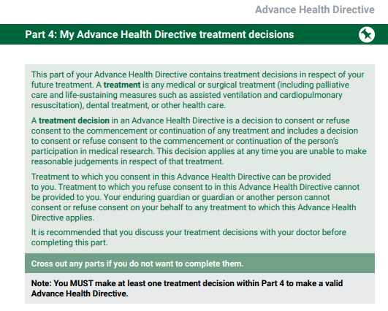
Requirements for a valid AHD
The revised AHD in WA
To be completed and signed by a competent adult about themselves
Must contain at least one treatment decision in Part 4
Needs to be signed and witnessed.
Notes:
An AHD must contain at least 1 treatment decision within Part 4. This can be in Part 4.1 life sustaining treatment decisions, 4.2 other treatment decisions, 4.3 Medical research
The person making an Advance Health Directive must sign in the presence of 2 witnesses. If they are physically incapable of signing this Advance Health Directive, they can ask another person to sign for them. They must be present when the person signs for them.
Each of the witnesses must be 18 years of age or older and cannot be the person making the Advance Health Directive or the person signing for them (if applicable).
At least one of the witnesses must be authorised by law to take statutory declarations. Schedule 2 of the Oaths, Affidavits and Statutory Declarations Act 2005 (external site) has the full list of people who can witness a statutory declaration. All registered health professionals and lawyers are included on this list.
The witnesses must also sign the Advance Health Directive. Both witnesses must be present when each of them signs. The person making the Advance Health Directive (and the person signing for them, if applicable) must also be present when the witnesses sign.

Slide 54
What is a health professional’s role with AHDs?
The revised AHD in WA
Locating the person’s AHD
Ask about AHDs as early as possible
Ask patient and/or their family/carer and/or GP
Check patient records AND My Health Record.
Store and communicate
If patient has an AHD, store AHD within patient’s record
Include in clinical handovers
Encourage person to upload to My Health Record.
Notes:
LOCATING YOUR PATIENT’S AHD
Ask about AHDs as early as possible
Ask your patient if they have an AHD
If they are unsure or cannot communicate:
Ask their family/carer and/or GP
Check patient records AND My Health Record.
Store and communicate
If patient has an AHD, raise a clinical alert in hospital settings and store AHD within patient’s record
Mention the AHD and other care planning discussions in clinical handovers including
Referrals
Discharge summaries
Outpatient correspondence
Encourage patients to upload their AHD to their My Health Record and support upload to My Health Record.

Slide 55
What is a health professional’s role with AHDs?
The revised AHD in WA
Caring for patients with an AHD
Linking with Goals of Patient Care (GoPC)
Discuss content of AHDs/ ACP documents during GoPC discussions.
Ensure GoPC forms align with the patient’s AHD.
Enact & follow
If patient doesn’t have decision-making capacity, refer to their AHD and:
    comply with the treatment decisions outlined within the AHD
    provide care in accordance with their values and preferences
    engage with the social work team to support families/carers with patient values and preferences
If the AHD does not cover the treatment decision required or they do not have an AHD:
  refer to the Hierarchy of treatment decision-makers
Review
Encourage person to review their AHD when their health changes or at least every 2 - 5 years.
Notes:
CARING FOR PATIENTS WITH AN AHD
Linking with Goals of Patient Care (GoPC) in relevant settings
Discuss content of AHDs/ advance care planning documents during GoPC discussions.
Ensure GoPC forms align with the patient’s AHD.
Enact & follow
If patient doesn’t have decision-making capacity, refer to their AHD and when relevant:
comply with the treatment decisions outlined within the AHD
provide care in accordance with their values and preferences
engage with the social work team to support families/carers with patient values and preferences
What if their AHD does not cover the treatment decision required or they do not have an AHD?
refer to the Hierarchy of treatment decision-makers (https://www.wa.gov.au/system/files/2022-02/treatment-decision-makers-heirarchy.pdf) for the order in which you must consult decision-makers.
Review
Encourage patients to review their AHD when their health changes or at least every 2 - 5 years.
NB. changes cannot be made to existing AHD. A new AHD can be made to replace previous AHD if the person still has decision-making capacity.

Slide 56
Organisational considerations to support ACP

Slide 57
Organisational considerations
Elements required to successfully deliver ACP
ACP leadership and governance
Everyone knows their role in ACP
Alert, storage and retrieval systems for ACP documents
ACP education and training
Quality and audit processes
Source: Advance Care Planning Australia
Notes:
Key message
Organisations need policies and procedures, staff education, quality and audit procedures, and storage systems for documentation in order to successfully implement advance care planning.
There are a variety of ways in which an organisation can support advance care planning. Elements required to successfully deliver advance care planning include:
Advance care planning policy and procedures
Establish governance
Promote initiatives
Everyone knows their role
Commitment and support from executives and clinical leaders
All healthcare workers can be involved
Systems to alert, store and retrieve
Advance care planning resources available in clinical areas
Advance care planning alert, storage and retrieval system
Education and training
Education of workforce to initiate and progress discussions
Promote research
Quality and audit processes
Regular auditing of advance care planning practice and quality
Link to safety and quality processes

Slide 58
Questions and case studies

Slide 59
Questions and case studies
Are the following statements true or false?
1a. Advance care planning should only be done when the person is dying.
1b. My patient has been diagnosed with dementia so I should consider talking to them about advance care planning.
1c. The Advance Health Directive and Enduring Power of Guardianship are formal tools that can be used for advance care planning.
1d. Martin would like to donate his organs after his death. He should identify this in his Advance Health Directive.
Notes:
1a. False. Advance care planning should be introduced early as part of routine care, rather than as a result of health decline or crisis.
1b.True. It is vital to start discussions about advance care planning early with people living with dementia. This helps to ensure that people can talk about how they would like their care to be managed in future while they still have full legal capacity.
1c. True. The Advance Health Directive and Enduring Power of Guardianship are statutory advance care planning documents available for use in WA.
1d. False. Advance Health Directives have no effect after death. An Advance Health Directive cannot be used to formally register interest in organ and tissue donation. Organ and tissue donation should be formally registered at https://www.donatelife.gov.au/join-register. It is important for a person to let their family know their wishes for organ and tissue donation, as relatives will be asked to agree after their death.

Slide 60
Questions and case studies
Diane is a 55-year-old woman whose mother has just died following a period of prolonged suffering due to a protracted illness.
Diane would like to avoid experiencing the same level of suffering if she becomes ill in future. In particular, she wants to ensure that if she becomes unable to communicate with her family, she would not be kept alive artificially.
She wants to know how she can legally ensure her wishes will be followed.
2. What is your advice?
Notes:
You can advise Diane of legislation in WA that allows her to make an Advance Health Directive in which she can state her medical treatment preferences in relation to being kept alive artificially. You can reassure Diane that the Advance Health Directive is a legal document and that the treatment decisions she describes in the document must be followed if she becomes unable to make or communicate her wishes. You should advise Diane that if she becomes unwell in future she should be counselled about her treatment options. You should also encourage Diane to tell her family and future medical specialists about her wishes.

Slide 61
Questions and case studies
Thomas is a 50-year-old man with acute kidney failure. He has dialysis several times a week and is no longer able to enjoy sports and other activities. He is aware that his life expectancy has been shortened by his condition. Thomas wants to complete an Advance Health Directive to refuse resuscitation. However, his wife has strong cultural and religious beliefs and does not agree. She would be his default substitute decision-maker and refuses to engage in the conversation. Thomas is confident that his wife would not honour his wishes and would instruct medical staff to perform resuscitation if a treatment decision was required.
3. What is your advice?
Notes:
You can advise Thomas that an Advance Health Directive is a legal document that must be followed by health professionals. Tell Thomas that he should give copies of his Advance Health Directive to his GP and hospital doctors. You can also suggest that he uploads his Advance Health Directive to his MyHealthRecord so that doctors and nurses can access it if required. You can also suggest that Thomas wears a MedicAlert bracelet which provides a phone number for health professionals to call and confirm his preferences for resuscitation in an emergency. You can also talk to Thomas about the option of appointing an alternative person as an enduring guardian (EPG) if he is concerned that his wife would be unable or unwilling to honour his preferences.
It would be worth counselling Thomas that making these preparations without his wife’s knowledge runs the risk of complications if the time comes to enact his decisions, and that there is a risk of causing her additional stress and emotional upset. You could suggest Thomas reads information from Advance Care Planning Australia to help guide the conversation with her or suggest he involves a third party to help facilitate the discussion.

Slide 62
Questions and case studies
Sam and his wife Joan have always been very open about the treatment preferences they would want at end-of-life. Sam has very strong opinions on artificial nutrition. He has stated in his Advance Health Directive that, if he becomes unable to feed himself in future, he refuses food or fluids including someone feeding him or artificial nutrition. Sam develops a rapidly progressive dementia and can no longer safely swallow. Without enteral feeding, Sam will die.
4a. You are aware that not feeding Sam will eventually result in his death. Should you follow his treatment wishes, and if so, will you expose yourself to criminal liability?
4b. Sam’s daughter disagrees with the treatment decision contained in his Advance Health Directive and says that it is wrong not to feed her father. Sam’s wife does not wish to be part of the discussion. What should you do?
Notes:
4a Health professionals must follow treatment decisions contained in a valid and operative Advance Health Directive. Sam has made a specific treatment decision that meets the current circumstances and you should respect this decision. The Guardianship and Administration Act 1990 and the Criminal Code provide exemption from criminal responsibility including the withdrawal and withholding of medical treatment where non-provision or cessation of treatment is done in good faith and is reasonable to all the circumstances of the case, even where death ensues.
4b. It is important to listen and respond to the daughter’s concerns. However, you should explain to the daughter that you are legally bound to the instructions Sam has given in his Advance Health Directive as it is a valid and operative document. You or Sam’s daughter can contact SAT if you have any concerns.

Slide 63
Education and resources to assist in your role

Slide 64
Education
For health professionals - Cancer Council WA’s Palliative and Supportive Education Program (PaSCE)
collectively creates a robust framework for advancing palliative care expertise, supporting the delivery of person-centred care across diverse healthcare settings through:
  Professional Development Education
  Volunteer Education
  Residential Aged Care Education in Palliative Care (RACEPC)
  Program of Experience in the Palliative Approach (PEPA)
  Palliative Care Scholarships
www.pasce.com.au 9382 9300
For the community - Palliative Care WA
Free ACP workshops
ACP Support service to assist people complete ACP documents
www.palliativecarewa.asn.au 1300 551 704
Notes:
Education opportunities are available for both health professionals and consumers.
Health professionals can refer patients to the ACP support service if they need assistance with completing ACP documents.

Slide 65
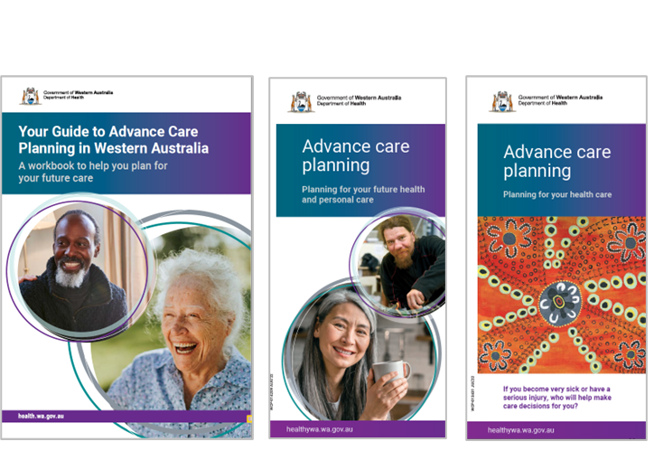
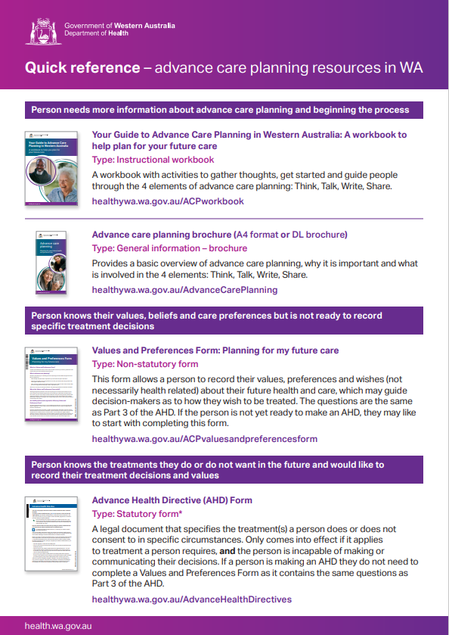
ACP Consumer Resources
Your Guide to ACP in WA: A workbook
ACP brochure and factsheet
ACP brochure for the Aboriginal community
AHD and ACP webpages and videos
Quick reference to ACP resources in WA
Notes:
The Department of Health has a range of consumer resources. Health Professional should familiarise themselves with what is available to be able to inform patients where to go for more information.
The range includes:
Your Guide to ACP in WA is a workbook to facilitate discussions. This consumer guide walks people through things to consider about their health, values, preferences and future care. And is a useful resource for people getting started.
There are webpages, videos and brochures that provide a good introduction to the topic
The Quick Reference to ACP resources in WA summarises the main resources and explains when they might be useful. it is a useful reference for both health professionals and for consumers to help with deciding what form might be right for them.

Slide 66
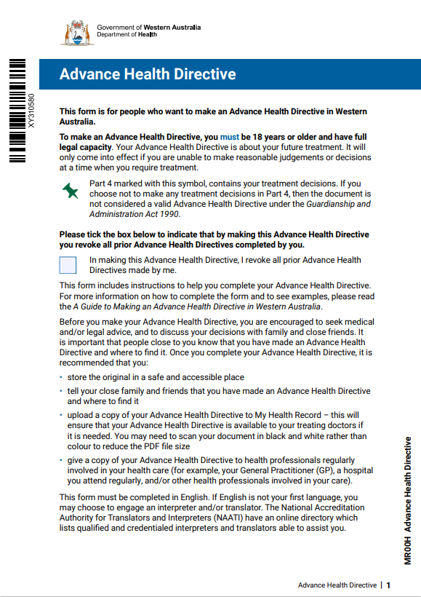

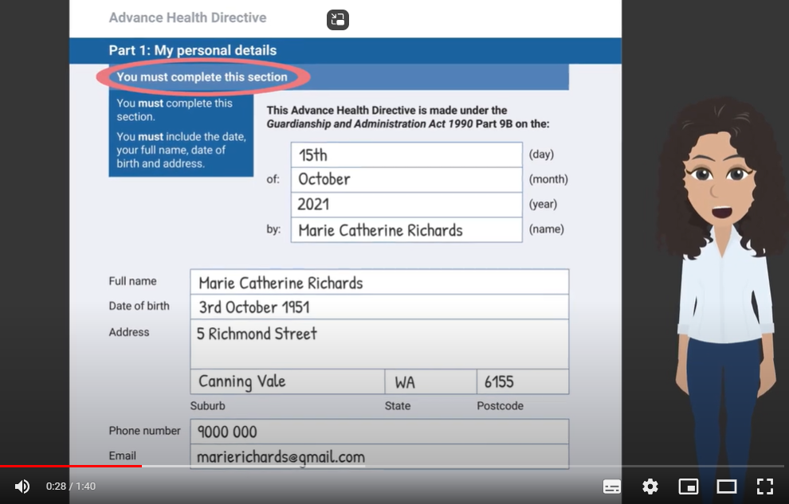
Advance Health Directive & Guide
Advance Health Directive
Guide to Making an Advance Health Directive in WA
  Booklet and video versions
Notes:
The Advance Health Directive is accompanied by a detailed step-by-step guide that walks people through completing the form.
This guide has also been made into a video series for those who prefer a more audio-visual format to digest the information. Available at healthywa.wa.gov.au/AdvanceCarePlanning

Slide 67

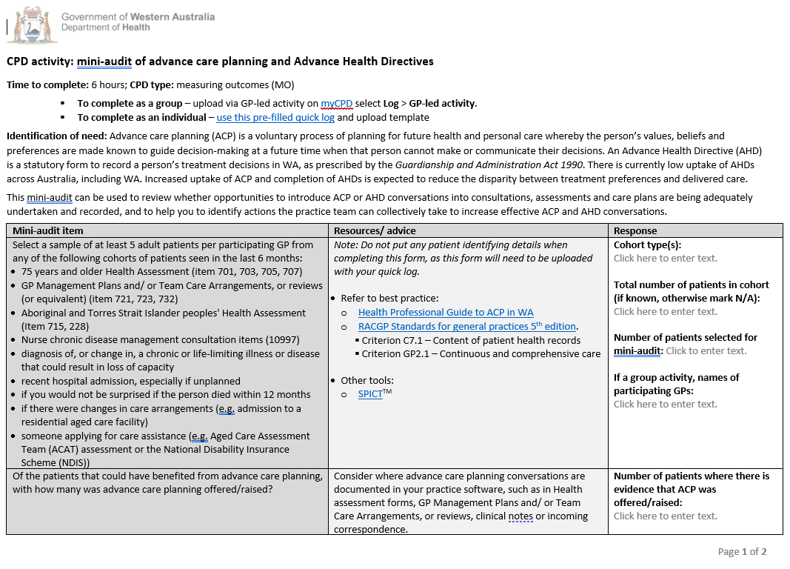
ACP Health Professional Resources
Health Professional Guide to ACP in WA
Health Professional AHD & ACP videos
Quick reference – Advance care planning resources in WA
Mini audit tool for GPs
Notes:
The Department of Health also have a number of health professional resources to help prepare them for the important role they play in supporting patients through ACP.
The Health Professional Guide to ACP in WA is a useful resource to understand your roles and responsibilities. It is a large document but it is broken up into sections so you can look for something in particular or there is a 2 page summary at the front which is also useful
There are a couple of short videos on the website
The Quick Reference to ACP resources in WA summarises the main resources and explains when they might be useful. it is a useful reference for both health professionals and for consumers to help with deciding what form might be right for them
A mini audit tool was also developed in collaboration with RACGP to allow GPs to audit if ACP conversations are being had with patients who would benefit from them and if so, are ACP documents being adequately stored.
The exercise can help identify actions that practice teams can collectively take to increase effective ACP and AHD conversations. Includes a pre-filled quick log for earning CPD hours.

Slide 68

Further information
Department of Health WA Advance Care Planning Information Line
​
General queries and to order free resources and documents
(e.g. Advance Health Directives)
(08) 9222 2300
ACP@health.wa.gov.au ​
​
health.wa.gov.au/ACP​
health.wa.gov.au/AHD​
Notes:
Read the Health Professional Guide to Advance Care Planning in WA to revisit the information presented in this session.
Contact the Department of Health WA Advance Care Planning Information Line for general information and to order copies of resources.

Slide 69
Acknowledgements
The following documents and resources informed the development of this Guide:
Department of Health WA. Health Professional Guide to Advance Care Planning in Western Australia. Perth: End-of-Life Care Program, Department of Health, Western Australia; 2022.
Palliative Care WA. Advance care planning introductory model. Perth, WA; Palliative Care WA ACP Consortium, 2022.
Advance Care Planning Australia. Factsheet for healthcare professionals. Austin Health, August 2018.
Nous Group. National Framework for Advance Care Planning Documents. Department of Health Australia, May 2021.

