Slide 1
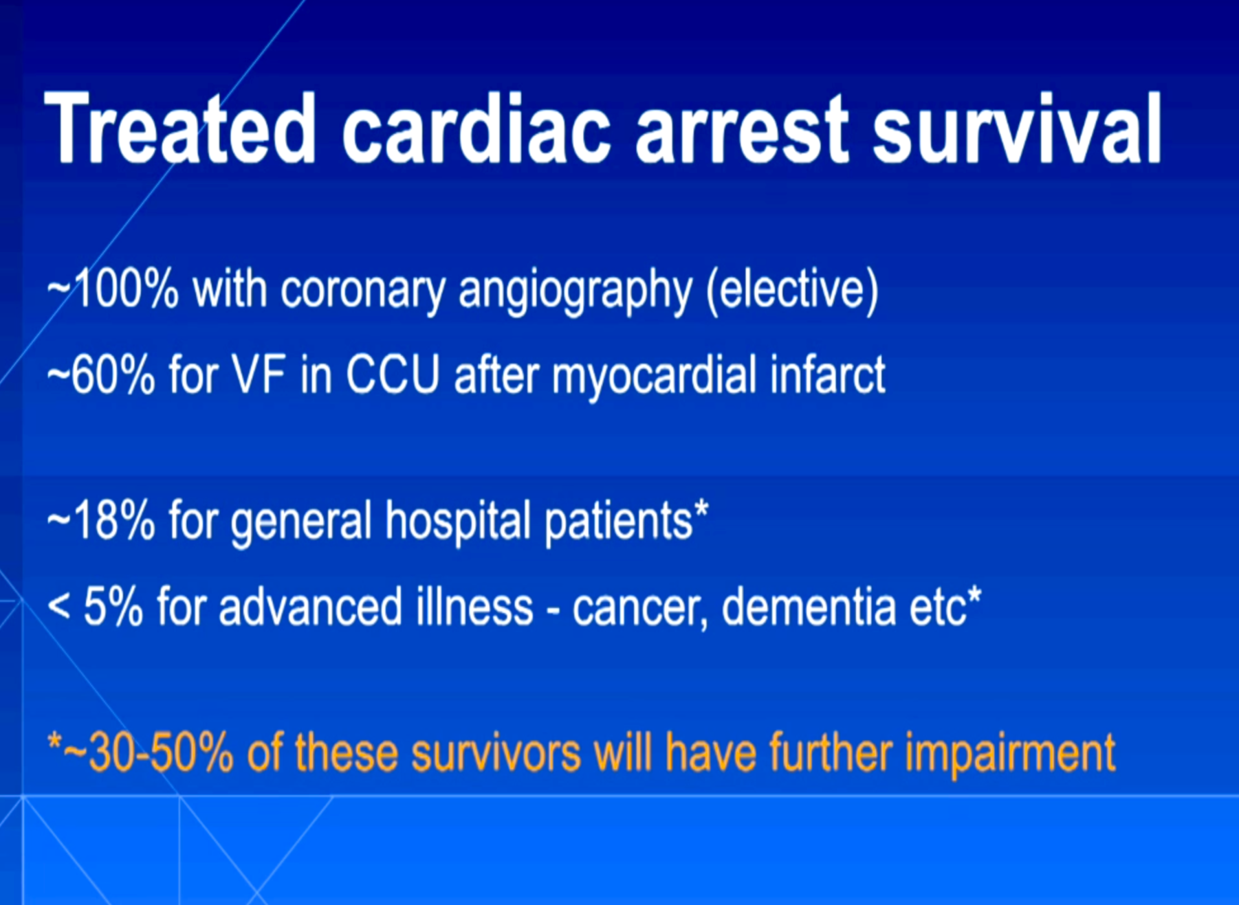
Notes:
Examples to illustrate the wide range of survival outcomes of CPR treated cardiac arrest. Reported survival outcomes also vary considerably between studies. This may, in part, relate to who is excluded from receiving CPR. It will be important to be aware of CPR outcomes in your own setting.

